Slide 1

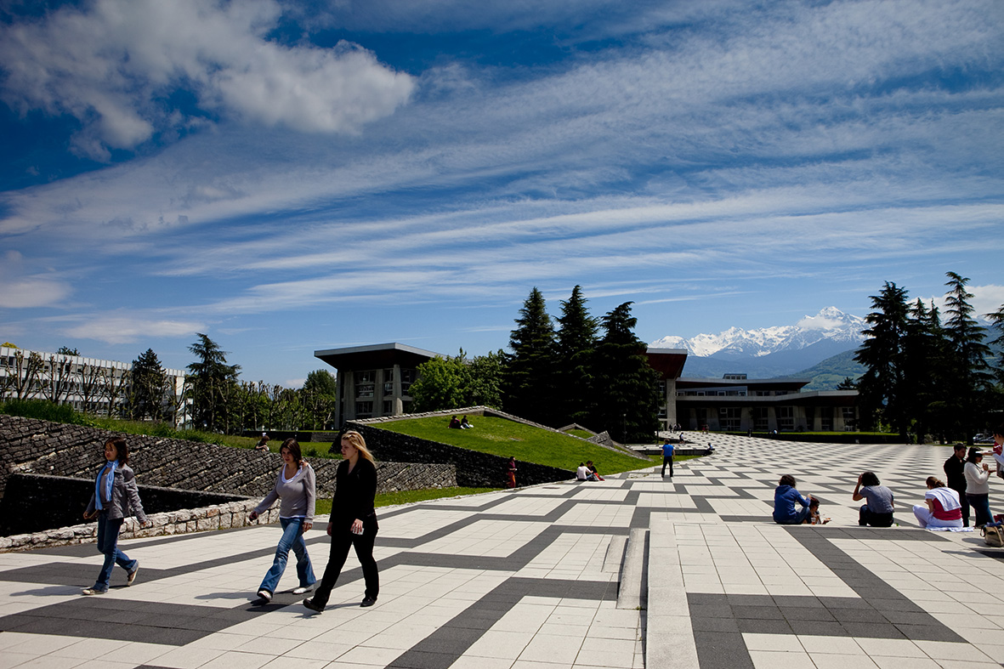

COMPUTER RESSOURCES
UFR IM²AG - 2019-2020

Slide 2
IT department: permanence and assistance
  IT department permanence for students: room 207a
  Monday to Thursday: 8:00-12:30 / 13:30-18:30
  Friday: 8:00-12:30 / 13:30-17:30
  Out of hours:
  Mail to im2ag-service-informatique@univ-grenoble-alpes.fr
  Open a ticket: http://im2ag-incidents.univ-grenoble-alpes.fr
2

Slide 3
IM2AG Wiki
You can find a lot of useful information on our Wiki:
http://im2ag-wiki.univ-grenoble-alpes.fr
  About computer ressources
  Printing
  How to connect to IM2AG computer ressources from home
  Technical details for computers or softwares, etc.
3

Slide 4
Lab rooms
UFR IM2AG has 22 lab rooms, mainly at 2nd floor.
Operational hours: 7:30 – 18:30 from Monday to Friday
You can use the lab rooms during the day if there are no scheduled courses.
Self service room: F021
  Access with student smartcard from October to July
  Opened from 18:30 to 21:00
Please, never unplug anything in lab rooms. Only use free power plugs.
For wired network, you can use the red RJ45 cables only: once connected, you will be redirected to a login portal. Use yourlogin@cuga.fr and your password as credentials. Please note that red cables are not available on all lab rooms yet.
4

Slide 5
UGA Accounts
For UGA students :
  You will have a UGA account when your registration is complete
  To get your credentials, follow the instructions on your scholarship certificate
  Your UGA account will be synchronized at INP within 24h after activation
  Only use UGA dashboard to change your password, and it will be synchronized at INP within 24h
  https://leo.univ-grenoble-alpes.fr is the UGA student portal. You will find here a lot of information, access to webmail, scheduling, password change, etc.
For INP students :
  You will have a INP account when your registration is complete
  Your INP account will be synchronized at UGA within 24h after activation
  Only use INP dashboard to change your password, and it will be synchronized at UGA within 24h
5

Slide 6
Accounts - During the first month
Some of you will have to use the computer resources for labs before having an official account.
If it’s the case, please request a temporary account to your teachers or to the IT department. A temporary account is personal and must not be shared, you are legally responsible for its use.
Temporary accounts will give you access to IM2AG computers and servers, but not to:
  UGA common resources (mail, printing, etc.)
  INP common resources
  Pedagogic platforms: Moodle, Alfresco, etc.
Temporary accounts are just here to help you before having an official account. Once you have an official account, stop using the temporary one.
6

Slide 7
UGA Webmail
To access to your university email address, connect on:
  https://leo.univ-grenoble-alpes.fr
You will find a link to your webmail on the dashboard.
On LEO, at the top right corner, by clinking on your name, it is possible to make a redirection from your university email address to your personnal email address.
Please note that it is not possible to access to university email address with POP/IMAP clients, you must use the webmail or make a redirection on another email address.
7

Slide 8
Home directory at IM2AG
Each UGA account have 7 Gb of storage.
Accessible from everywhere at IM2AG:
  Windows: on network drive named Z:\
  Ubuntu and pedagogic servers: directory named /u/ or /home/
Autosaves accessible under /u/.snapshots/ directory:
  1 weekly save
  6 daily saves
8

Slide 9
Printing
One printer is available at the 2nd floor: you can print from the computers with the printer named “IMPRESSION_UGA”.
When your print is sent to the printer, it will not be printed until you come to the printer and login on the printer screen or with you student card.
Each student have a printing quota that can be recharged by credit-card if needed, using the following link: https://impression.univ-grenoble-alpes.fr
The printer can also be used to make photocopies: you can print the copied document (which uses your printing quota) or send it to your UGA email address in PDF format (which is free and unlimited).
9

Slide 10
WiFi access
SSID: wifi-campus
Access from all places on the campus
First way of connection: captive portal (for web access only)
  Connect to the WiFi
  Try to access to any webpage with your web browser
  You will be redirected to the connection portal
  Authenticate with UGA account
Second way of connection: VPN (for web and pedagogic resources)
  Connect to the WiFi
  Follow instructions on http://vpn.grenet.fr to install VPN client
  Authenticate with the AGALAN account
  Please note that VPN access also work from home
10

Slide 11
Useful links
UFR IM2AG website: http://im2ag.univ-grenoble-alpes.fr/
UGA website: http://univ-grenoble-alpes.fr/
ENSIMAG website: http://ensimag.grenoble-inp.fr/
UGA student portal https://leo.univ-grenoble-alpes.fr where you will find:
  Links to your email address
  Link to the ADE schedule
  Account management (password change, etc.)
UGA Moodle: https://im2ag-moodle.e.ujf-grenoble.fr/
ENSIMAG Moodle: https://caseine.org/
11

